Slide 1
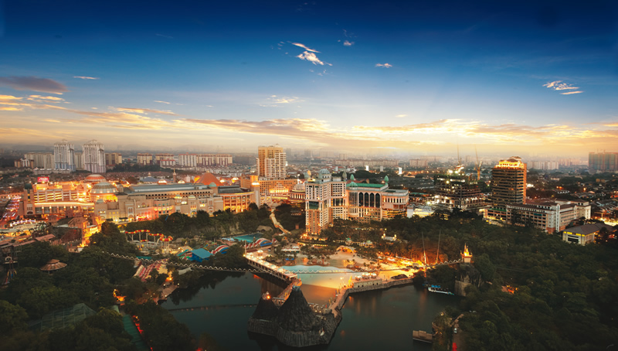
Established in 1974, Sunway Group is one of Malaysia’s largest public listed property-construction corporations with a combined market capitalisation of RM13 billion, a 15,000-strong employee base and 12 business divisions across 50 locations worldwide.

Slide 2
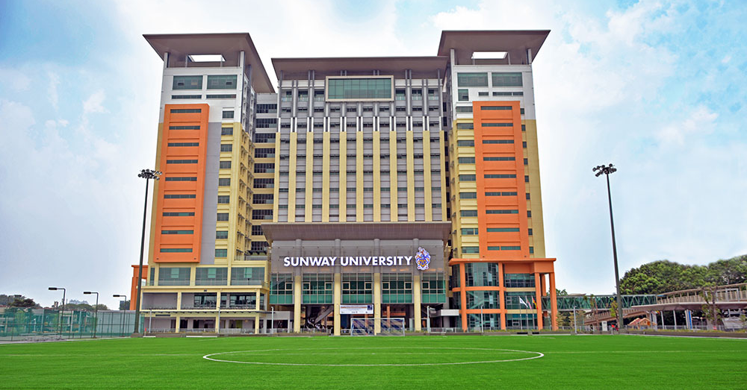

Slide 3
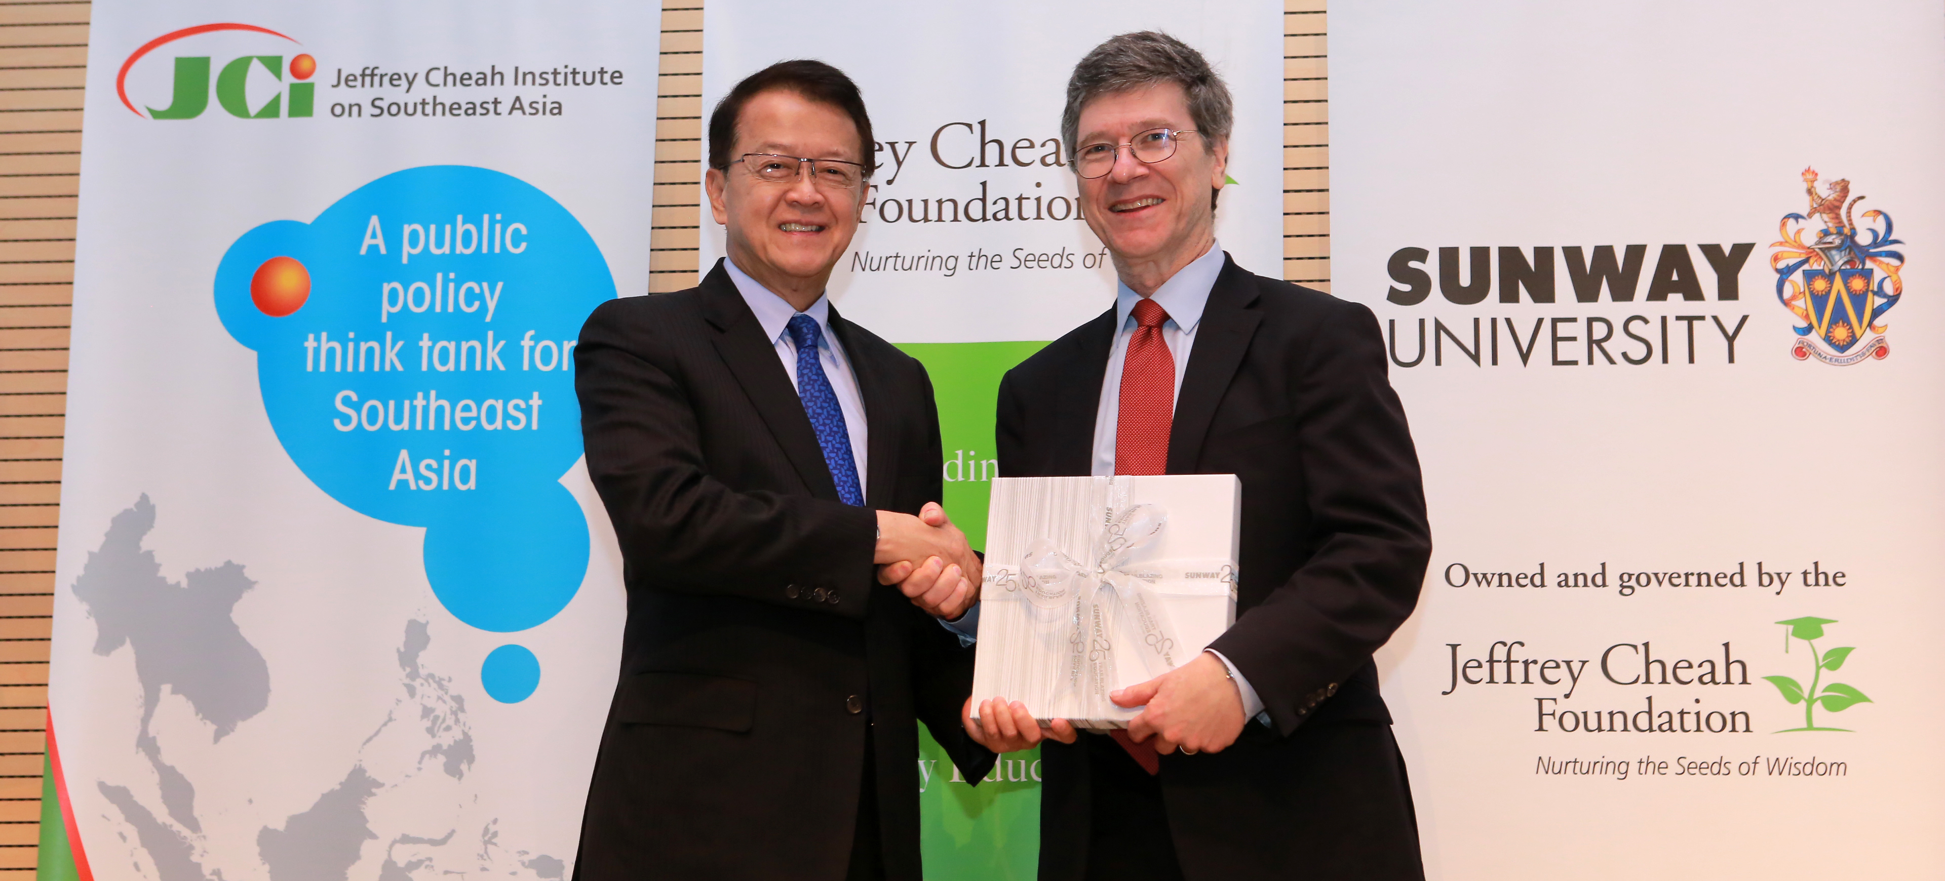
Jeffrey Sachs Centre for Sustainable Development

Slide 4
Working with Dialogue in the Dark since 2015 to set up a learning centre at Sunway

Slide 5
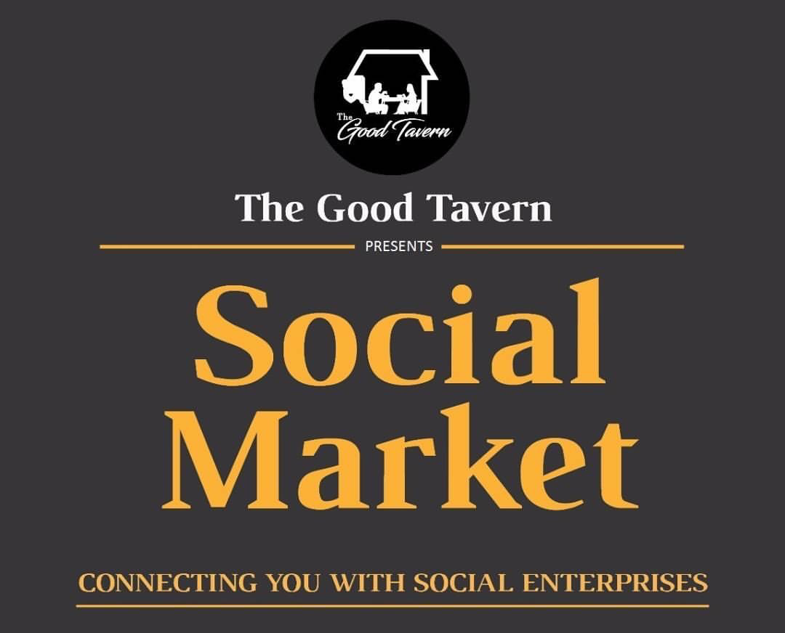
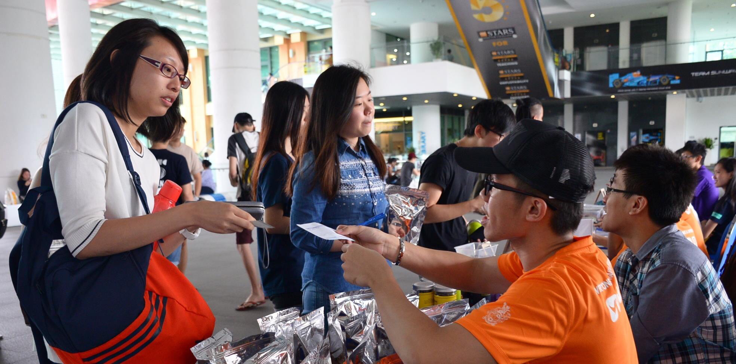
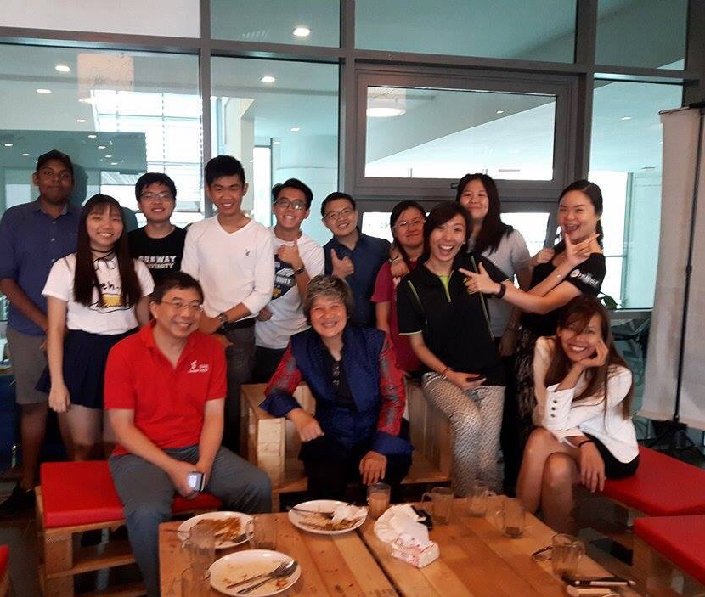
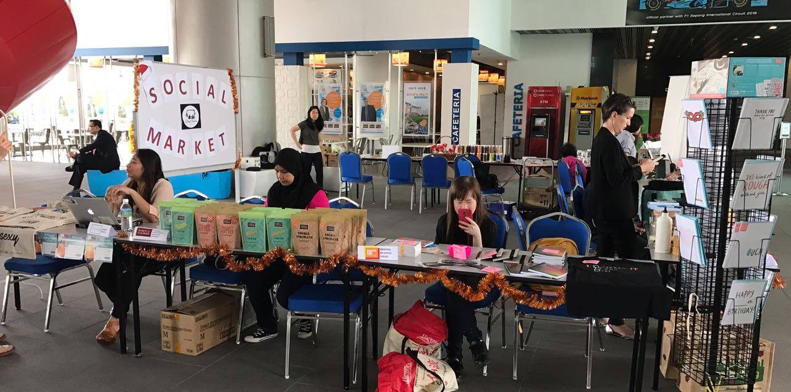

Slide 6
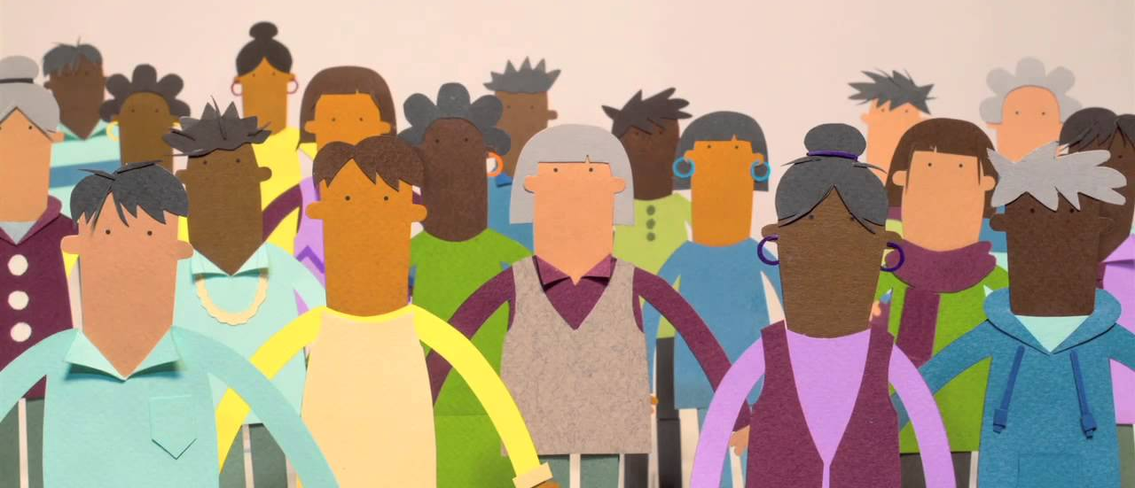

Slide 7
Partnership with Ashoka
Social innovation mapping of change makers
Ashoka Fellow roundtables

